Slide 1

Quantization Workflows to Optimize Model Accuracy and Deployment Performance for LLMs
Undergraduate Project Report
Khushi Sahu (220532) | Shikhar Chaurasia (221009)
Supervisor: Prof. R. M. Hegde
Department of Electrical Engineering
Indian Institute of Technology Kanpur

Slide 2
Contents
Abstract
Model Comparison
Introduction
Evaluation Metrics (BLEU)
Problem Statement
Evaluation Metrics (METEOR)
Objective
Evaluation Metrics (ROUGE)
Background: Quantization
COCO Dataset Evaluation
Quantization Techniques
Results (INT8)
Multimodal Models
Results (INT4)
Relative Size of Models
Results Summary
Types of INT4
Conclusion
Types of INT8

Slide 3
Abstract
Quantization is a key model compression technique that reduces floating-point weights and activations into low-bit integer representations for efficient deployment. This report presents a complete study of INT8/INT4 formats, block-wise strategies, and the GGUF format. It also covers multimodal models and their evaluation metrics (BLEU, METEOR, ROUGE) on the COCO dataset, consolidating the theoretical, architectural, and evaluation aspects of quantization.

Slide 4


Introduction
The Rise of LLMs
The Deployment Challenge
Large Language Models (LLMs) and multimodal systems have grown exponentially, often containing billions of parameters. They achieve remarkable performance on tasks like reasoning, image understanding, and text generation.
Deploying these models in full FP32 or FP16 precision is impractical for most real-world hardware (laptops, mobile devices). Quantization addresses this by reducing numerical precision, enabling 4-16x size reductions and improving speed, while preserving accuracy.

Slide 5






Problem Statement: Core Limitations
High Memory Footprint
Memory-Bound Inference
Restricted Deployability
A model like LLAMA-70B requires more than 140 GB of memory in FP16 precision, far exceeding standard hardware capabilities.
Transformer inference is memory-bound. The repeated retrieval of large weight matrices from RAM creates a significant latency bottleneck.
Running FP32 or FP16 LLMs on CPUs or mobile devices is largely infeasible, necessitating high-end GPUs with large VRAM.

Slide 6
Project Objectives
Understand Quantization: Develop a clear understanding of quantization and its importance for efficient LLM deployment.
Analyze Methods: Examine the theoretical basis of INT8, INT4, and blockwise methods used in modern LLMs.
Study GGUF Format: Study the GGUF model format designed for optimized inference.
Explore Multimodal Models: Explore the architecture of multimodal image-text to text models.
Evaluate Performance: Evaluate performance using standard metrics (BLEU, METEOR, ROUGE) on the COCO benchmark.

Slide 7




Background: Quantization Concepts
Definition: Quantization is the process of mapping continuous floating-point values to a reduced set of discrete integer levels. It is applied to model weights and activations to reduce storage and improve computation efficiency. A model with N parameters requires:
4N
2N
N
0.5N
FP32 (Bytes)
FP16 / BF16
INT8 (Bytes)
INT4 (Bytes)

Slide 8






Quantization Techniques
Post-Training (PTQ)
Blockwise (LLAMA)
GGUF Format
Weights are quantized after training. Simple and efficient. Includes *Dynamic* (activations quantized at runtime) and *Static* (uses calibration data) methods.
A fine-grained approach. Weights are split into blocks (32/64 elements), each gets its own scale value, then values are quantized. Reduces error.
Used by llama.cpp. Stores tokenizer, hyperparameters, quantized weights, and per-block scales. Loads quickly and runs efficiently on CPUs.

Slide 9
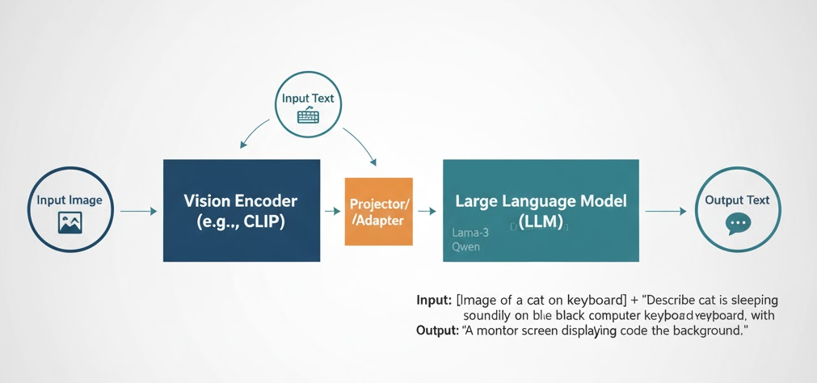
Multimodal Models (Image-Text)
Definition
Multimodal models integrate information from both images and text to generate coherent textual responses.
Components:
1.
Vision Encoder (e.g., CLIP): Extracts features from the image.
2.
Fusion Mechanism: Aligns visual and textual representations.
3.
Language Model (LLM): A decoder that produces the final text output.

Slide 10
Multimodal Training & Examples
Training Approaches: Involves contrastive learning, instruction tuning, caption-generation training, and visual question answering (VQA) datasets.
Input Image | Prompt | Output
Picture of a dog | 'Describe the image.' | "A brown dog running on the grass".
Chart | 'What is profit trend?' | 'Profit increases steadily... then declines'.
Screenshot of webpage | 'Extract all menu items.' | 'Home, About, Contact, Services...'
Photo of math question | 'Solve this.' | 'The answer is x=5'

Slide 11
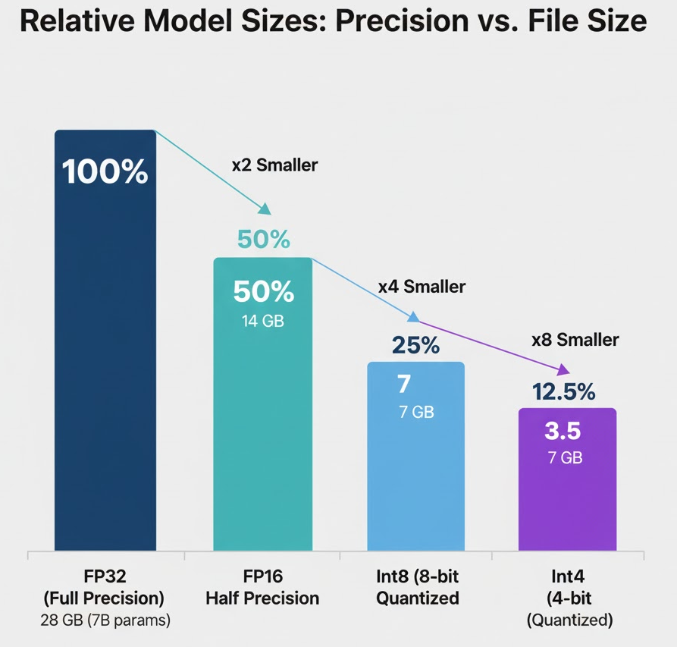
Relative Model Sizes
Precision vs. File Size
This chart (based on Fig. 3) shows the size of a 7B parameter model at different precisions:
•
FP32: 28 GB (100%)
•
FP16: 14 GB (50%)
•
INT8: 7 GB (25%)
•
INT4: 3.5 GB (12.5%)
Other precisions like BF16 offer a larger dynamic range than FP16, while INT2 is used for ultra-low-memory environments.

Slide 12
Types of INT4 Quantization
Q4_0: Simplest 4-bit quantization method using per-block scaling with no zero-point. It offers the fastest performance and smallest memory footprint.
Q4_1: Extends Q4_0 by adding a zero-point, enabling better handling of shifted or asymmetric weights. This increases expressiveness and typically improves accuracy.
Q4_KM: Uses group-wise (K-quant) blocks with optimized scaling for maximum stability. It delivers the highest accuracy among INT4 methods, closely preserving FP16 behavior.
Q4_KS: Symmetric variant of K-Quant optimized for weight distributions centered around zero. It provides high stability with lower overhead by removing the zero-point.

Slide 13
Types of INT8 Quantization
Q8_0: Basic and widely used INT8 format with per-block scaling and no zero-point. Simple, fast, and stable for most layers. Offers a good balance of accuracy and performance.
Q8_K: K-quant optimized INT8 format using group-wise scaling. Significantly reduces quantization error and improves accuracy. Highly effective for larger models like LLaMA and Qwen.
Q8_S: Symmetric INT8 variant with no zero-point, assuming weights are centered around zero. Simplifies computation and improves speed. Works best when weight distributions are naturally symmetric.
.

Slide 14
Vision-Language Model Comparison
Model | Params | Strengths | Weaknesses | Ideal For
Qwen | 3B, 7B | Strong reasoning, coding capability, multilingual support | 7B: Heavy at slower than lightweight models | Reasoning tasks, coding, multilingual inference
LLAVA | 7B, 8B | Strong VLM alignment, good captioning and VQA | Weaker long-form reasoning | Captioning, multimodal chat, VQA
MiniCPM | 4B, 8B | Efficient, lightweight, quantization-friendly | Not strong in math or deep reasoning | Edge deployment, quantized inference

Slide 15

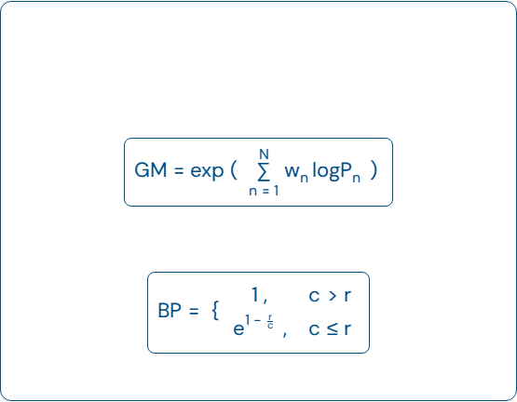
Evaluation Metric: BLEU
BLEU (Bilingual Evaluation Understudy)
Key Formulas (MathML)
Geometric Mean (GM):
Measures n-gram overlap between generated and reference captions. It combines n-gram precision (P) using a Geometric Mean (GM) and applies a Brevity Penalty (BP) for short sentences.
Brevity Penalty (BP):
BLEU = BP × GM

Slide 16

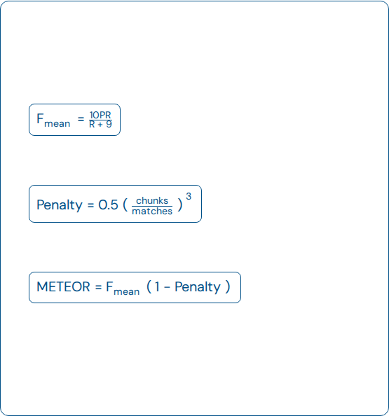
Evaluation Metric: METEOR
METEOR Steps
Key Formulas (MathML)
Aligns closely with human judgment by evaluating semantic similarity.
Weighted F-Score (F_mean):
1.
Unigram Matching: Matches words via exact, stem, synonym, and paraphrase.
Fragmentation Penalty:
2.
Compute P & R:
P=matched unigram/candidate unigram
R=matched unigram/reference unigram
Final METEOR Score:
3.
Weighted F-Score: Calculates F_mean, giving 9x more weight to recall.
4.
Fragmentation Penalty: Penalizes scattered matches.
5.
Final Score: Combines F_mean and Penalty.

Slide 17
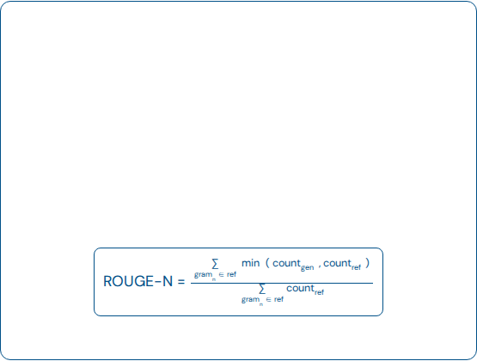
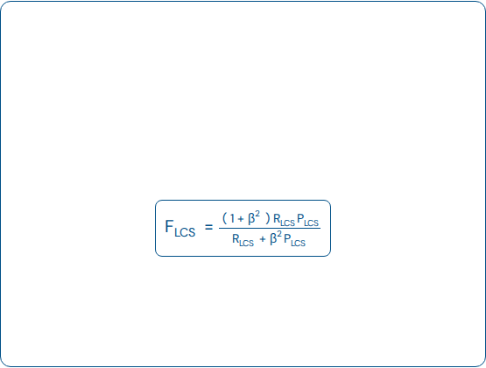
Evaluation Metric: ROUGE
ROUGE (Recall-Oriented...)
ROUGE-L
A recall-focused metric that measures how much of the reference content is captured by the generated text.
Evaluates sentence-level structure using the Longest Common Subsequence (LCS).
LCS F-Score (weights recall):
ROUGE-N: Computes recall over matching n-grams.

Slide 18
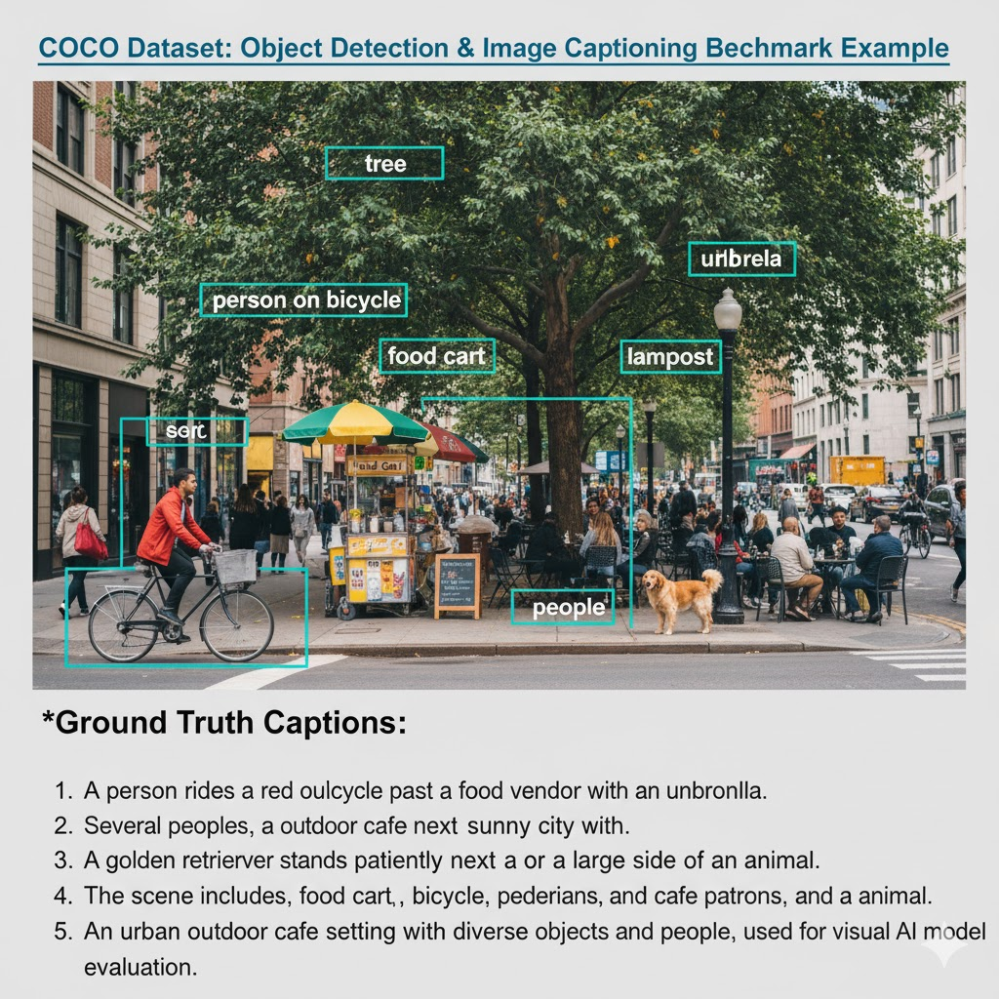
Benchmark: COCO Dataset
Image Captioning Benchmark
The COCO (Common Objects in Context) dataset contains over 330,000 images.
Each image is accompanied by five human-written "ground truth" captions, providing a reliable basis for evaluation.
Ground Truth Example:
"1. A person rides a red bicycle past a food vendor."

Slide 19
Results: INT8 Quantization
Model | Params | Quant. | Size | Latency | BLEU | METEOR | ROUGE
Qwen 2.5 | 7B | Q8-0 | 8.10 GB | 8.289 | 0.0118 | 0.2202 | 0.1207
Qwen 2.5 | 3B | Q8-0 | 3.29 GB | 5.084 | 0.0007 | 0.1491 | 0.0521
MiniCPM V4.5 | 8B | Q8-0 | 8.71 GB | 22.07 | 0.0124 | 0.1659 | 0.1479
MiniCPM V4 | 4B | Q8.0 | 3.83 GB | 5.834 | 0.0136 | 0.1969 | 0.1423
LLAVA 1.6 | 7B | Q8_0 | 7.70 GB | 24.33 | 0.0162 | 0.2113 | 0.1235
LLAVA 3 | 8B | Q8-0 | 8.54 GB | 4.598 | 0.0428 | 0.1833 | 0.5056

Slide 20
Results: INT4 Quantization
Model | Params | Quant. | Size | Latency | BLEU | METEOR | ROUGE
Qwen 2.5 | 7B | BF16 | 15.2 GB | 14.276 | 0.0174 | 0.2277 | 0.1265
Qwen 2.5 | 7B | Q4 KM | 4.68 GB | 3.544 | 0.0099 | 0.2209 | 0.1215
Qwen 2.5 | 3B | BF16 | 6.18 GB | 8.136 | 0.0009 | 0.1473 | 0.0531
Qwen 2.5 | 3B | Q4 KM | 1.93 GB | 2.527 | 0.0008 | 0.1429 | 0.0494
MiniCPM V4.5 | 8B | Q4 KM | 5.03 GB | 7.458 | 0.0036 | 0.1134 | 0.1536
MiniCPM V4 | 4B | Q4 KM | 2.19 GB | 4.923 | 0.0103 | 0.1276 | 0.1423
LLAVA 1.6 | 7B | Q4 KM | 4.37 GB | 12.802 | 0.0136 | 0.2066 | 0.0785
LLAVA 3 | 8B | Q4 KM | 4.92 GB | 2.690 | 0.4170 | 0.2667 | 0.1853

Slide 21
Results Summary
INT8 Performance
INT4 Performance
INT8 quantization (Q8_0) preserves accuracy well across all models. Qwen 2.5 (7B) and LLaVA 1.6 achieve some of the strongest METEOR and ROUGE performance, indicating good retention of semantic quality.
INT4 quantization (Q4_KM) significantly reduces model size and latency. MiniCPM 4B (2.19 GB) and Qwen 3B (1.93 GB) become highly suitable for edge deployment. LLaVA 3 (8B) shows exceptionally strong BLEU/METEOR scores, demonstrating that Q4_KM retains high captioning quality.

Slide 22
Conclusion
Quantization is a crucial technique for enabling the deployment of large language models and multimodal systems on standard hardware. Methods such as INT8 and INT4, along with fine-grained blockwise approaches, allow substantial reductions in memory and computational requirements while preserving model accuracy. The GGUF format further enhances inference efficiency on CPU/mobile platforms. Evaluations show quantized models deliver competitive performance.

